Slide 1
PeerWise Cycle 3
Feedback

Slide 2
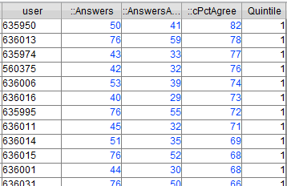
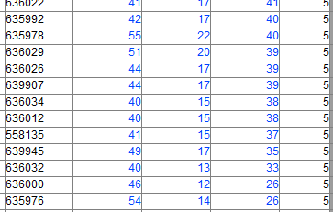
Determining Quintiles
Students answering 40+ questions were sorted according to % correctness
And some other factors taken into some consideration
Number of questions done
Difficulty spread attempted
Time spent
Number of ‘quicks’
Top 20% - Quintile 1
Bottom 20% - Quintile 5

Slide 3
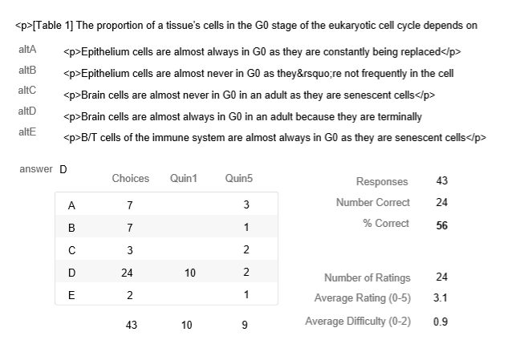
Part of the question stem and options
Just enough shown to recognise your question
Horrid HTML not removed
The answer as set by the AUTHOR
The objective measure of ‘difficulty’
Subjective student ratings and their scales
The number of people choosing each option
The number of people in the two extreme quintiles choosing each option

Slide 4
What Next?
No action necessary
Marks for your answering computed soon
If you want to (NOT compulsory)
Edit your question in Cycle 2
Will open Cycle 2 soon for this
Hassle me for more interesting metrics
Students can disagree with the answer – this triggers data
How did the past-paper questions fare vs the student questions?

Slide 5
Marking
Expected 40 questions done earnestly
Main indicators included
Time spent per question
Number of quicks – CONTAMINATION!
Other indicators of thoughtfulness (not taken into account unless borderline)
Challenge to answer
Periods of engagement
Correctness of answer
Leaving comments/ratings
Start date
And more…..

Slide 6
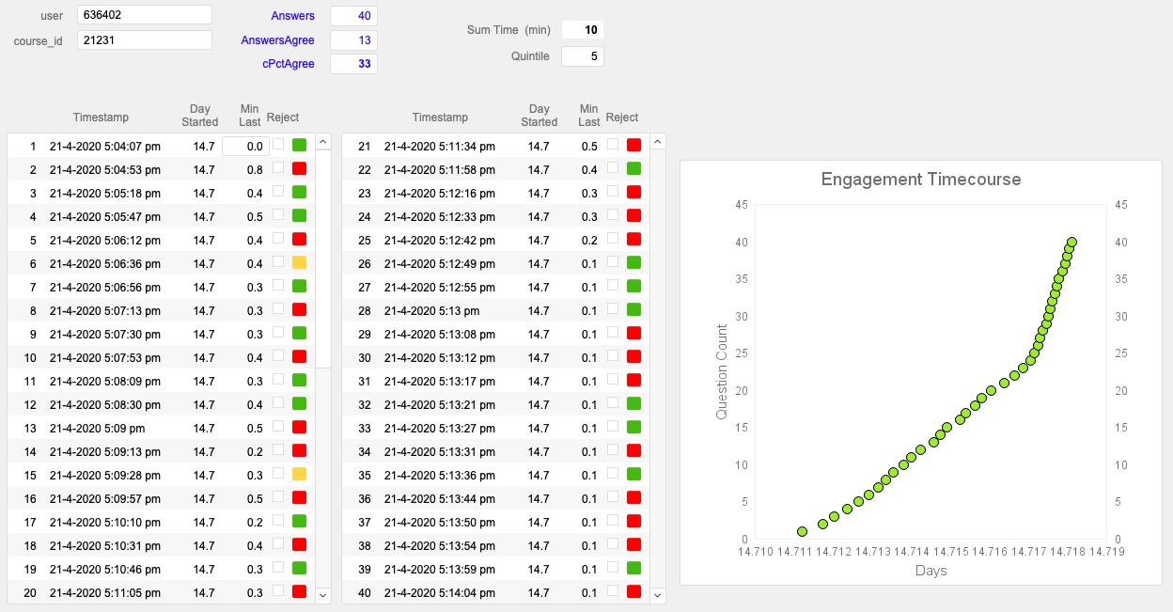
NOT thoughtful

Slide 7
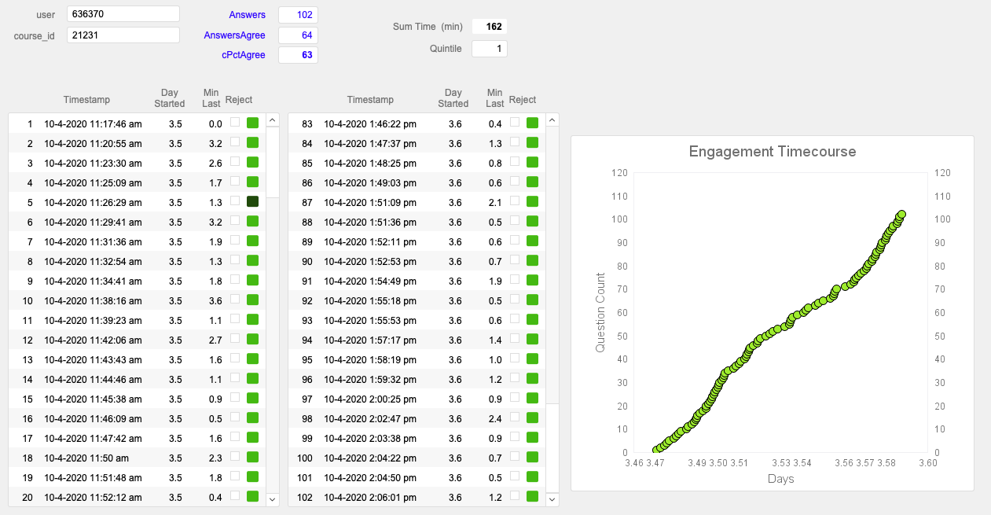
Thoughtful

Slide 8
Marking Criteria
Time per question (min, average)
0.3
0.5
0.8
1
Thoughtfulness
Green is full marks
Red indicates increasing loss of marks
Number of Quicks
10
5
3
2
1
0
Contamination
Number of Answers
40
80
Number Done on time

